Slide 1
De-mystifying Deep Learning
Anusua Trivedi
Data Scientist
Email: antriv@microsoft.com Twitter: @anurive

Slide 2
Talk Outline
Deep Learning (DL)
Deep Neural Networks (DNN)
Types of DNNs
DL Frameworks
Use Cases

Slide 3
Resources
https://aka.ms/mlads2016_deeplearning

Slide 4
Traditional ML Vs DL
Traditional ML requires manual feature extraction/engineering
Feature extraction for unstructured data is very difficult
Deep learning can automatically learn features in data​
Deep learning is largely a "black box" technique, updating learned weights at each layer

Slide 5
Why is DL popular?
DL models has been here for a long time
Fukushima (1980) – Neo-Cognitron
LeCun (1989) – Convolutional Neural Network
DL popularity grew recently
With growth of Big Data
With the advent of powerful GPUs

Slide 6
Deep learning begins with a little function
It all starts with a humble linear function called a perceptron.
weight1 ✖ input1
weight2 ✖ input2
weight3 ✖ input3
sum
Perceptron:
If sum > threshold: output 1
Else: output 0
✚
Example: The inputs can be your data. Question: Should I buy this car?
0.2 ✖ gas mileage
0.3 ✖ horsepower
0.5 ✖ num cup holders
sum
Perceptron:
If sum < threshold: buy
Else: walk
✚

Slide 7
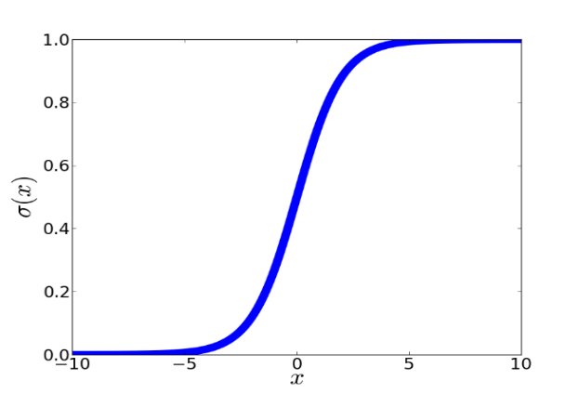
These little functions are chained togeter
Deep learning comes from chaining a bunch of these little functions together. Chained together, they are called neurons.
weight3 ✖ input3
weight1 ✖ input1
weight2 ✖ input2

Slide 8

Deep Neural Network (DNN)
*http://neuralnetworksanddeeplearning.com/chap5.html

Slide 9
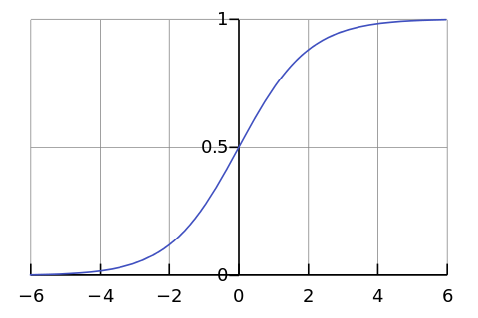
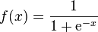
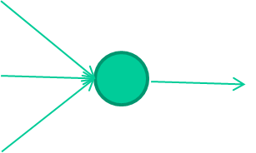
-0.06
W1
W2
f(x)
-2.5
W3
1.4

Slide 10
-0.06
2.7
-8.6
f(x)
-2.5
0.002
x = -0.06×2.7 + 2.5×8.6 + 1.4×0.002 = 21.34
1.4

Slide 11
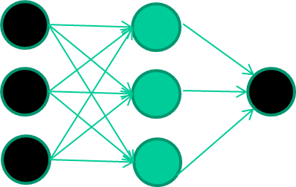
A dataset
Fields class
1.4 2.7 1.9 0
3.8 3.4 3.2 0
6.4 2.8 1.7 1
4.1 0.1 0.2 0
etc …

Slide 12
Training the neural network
Fields class
1.4 2.7 1.9 0
3.8 3.4 3.2 0
6.4 2.8 1.7 1
4.1 0.1 0.2 0
etc …

Slide 13
Training data
Fields class
1.4 2.7 1.9 0
3.8 3.4 3.2 0
6.4 2.8 1.7 1
4.1 0.1 0.2 0
etc …
Initialise with random weights

Slide 14
Training data
Fields class
1.4 2.7 1.9 0
3.8 3.4 3.2 0
6.4 2.8 1.7 1
4.1 0.1 0.2 0
etc …
Present a training pattern
1.4
2.7
1.9

Slide 15
Training data
Fields class
1.4 2.7 1.9 0
3.8 3.4 3.2 0
6.4 2.8 1.7 1
4.1 0.1 0.2 0
etc …
Feed it through to get output
1.4
2.7 0.8
1.9

Slide 16
Training data
Fields class
1.4 2.7 1.9 0
3.8 3.4 3.2 0
6.4 2.8 1.7 1
4.1 0.1 0.2 0
etc …
Compare with target output
1.4
2.7 0.8
0
1.9 error 0.8

Slide 17


Training data
Fields class
1.4 2.7 1.9 0
3.8 3.4 3.2 0
6.4 2.8 1.7 1
4.1 0.1 0.2 0
etc …
Adjust weights based on error
1.4
2.7 0.8
0
1.9 error 0.8

Slide 18
Training data
Fields class
1.4 2.7 1.9 0
3.8 3.4 3.2 0
6.4 2.8 1.7 1
4.1 0.1 0.2 0
etc …
Present a training pattern
6.4
2.8
1.7

Slide 19
Training data
Fields class
1.4 2.7 1.9 0
3.8 3.4 3.2 0
6.4 2.8 1.7 1
4.1 0.1 0.2 0
etc …
Feed it through to get output
6.4
2.8 0.9
1.7

Slide 20
Training data
Fields class
1.4 2.7 1.9 0
3.8 3.4 3.2 0
6.4 2.8 1.7 1
4.1 0.1 0.2 0
etc …
Compare with target output
6.4
2.8 0.9
1
1.7 error -0.1

Slide 21
Training data
Fields class
1.4 2.7 1.9 0
3.8 3.4 3.2 0
6.4 2.8 1.7 1
4.1 0.1 0.2 0
etc …
Adjust weights based on error
6.4
2.8 0.9
1
1.7 error -0.1

Slide 22
Training data
Fields class
1.4 2.7 1.9 0
3.8 3.4 3.2 0
6.4 2.8 1.7 1
4.1 0.1 0.2 0
etc …
And so on ….
6.4
2.8 0.9
1
1.7 error -0.1
Repeat this thousands, maybe millions of times – each time
taking a random training instance, and making slight
weight adjustments
Algorithms for weight adjustment are designed to make
changes that will reduce the error

Slide 23
The decision boundary perspective…
Initial random weights

Slide 24
The decision boundary perspective…
Present a training instance / adjust the weights

Slide 25
The decision boundary perspective…
Present a training instance / adjust the weights

Slide 26
The decision boundary perspective…
Present a training instance / adjust the weights

Slide 27
The decision boundary perspective…
Present a training instance / adjust the weights

Slide 28
The decision boundary perspective…
Eventually ….

Slide 29
The point we are trying to make here
Weight-learning algorithms for NNs are dumb
They work by making thousands and thousands of tiny adjustments, each making the network work better
Eventually the cumulation of all these bits tends to be good enough to learn effective classifiers for many real applications

Slide 30
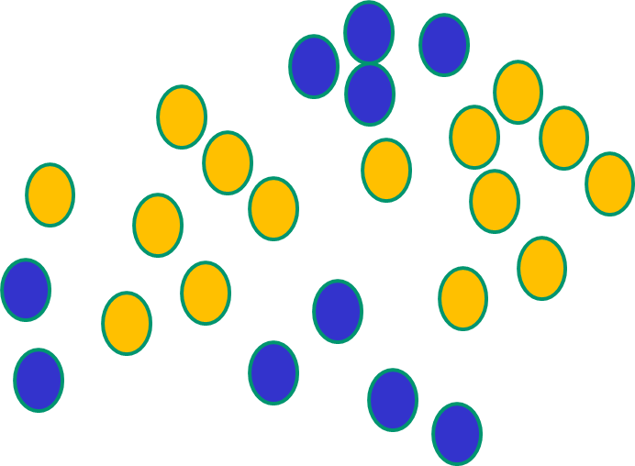
Some other ‘by the way’ points
If f(x) is linear, the NN can only draw straight decision boundaries (even if there are many layers of units)

Slide 31
Some other ‘by the way’ points
NNs use nonlinear f(x) so they
can draw complex boundaries,
but keep the data unchanged

Slide 32
Some other ‘by the way’ points
NNs use nonlinear f(x) so they SVMs only draw straight lines,
can draw complex boundaries, but they transform the data first
but keep the data unchanged in a way that makes that OK

Slide 33
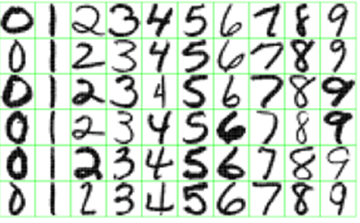
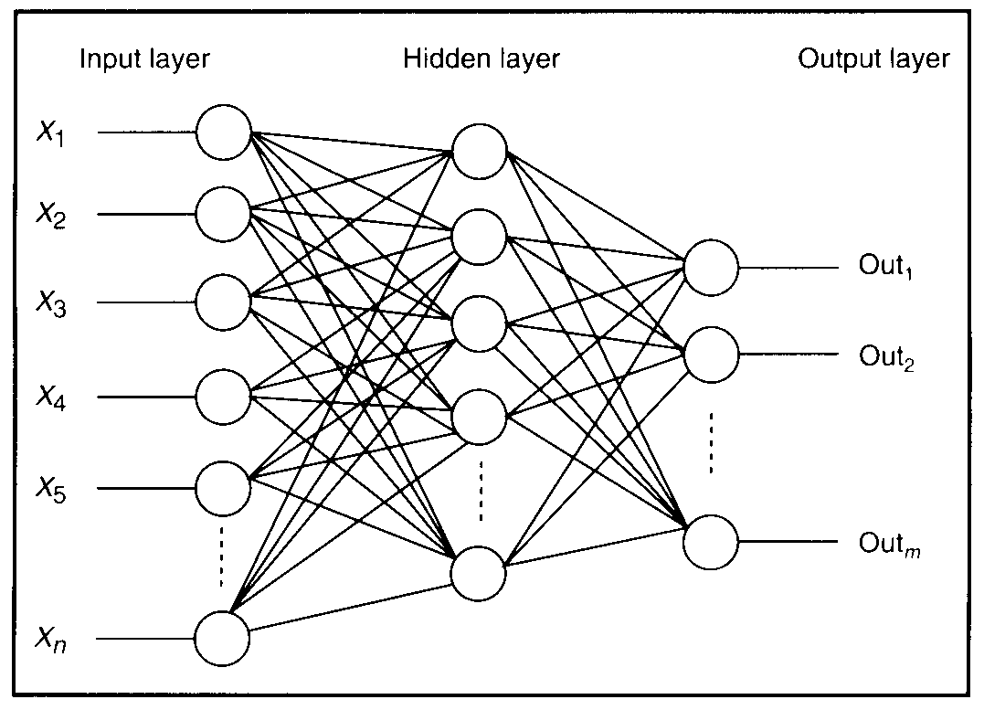
Feature detectors

Slide 34
what is this unit doing?

Slide 35
Hidden layer units become self-organised feature detectors
1 5 10 15 20 25 …
…
1
strong +ve weight
low/zero weight
63

Slide 36
What does this unit detect?
1 5 10 15 20 25 …
…
1
strong +ve weight
low/zero weight
63

Slide 37
What does this unit detect?
1 5 10 15 20 25 …
…
1
strong +ve weight
low/zero weight
it will send strong signal for a horizontal
line in the top row, ignoring everywhere else
63

Slide 38
What does this unit detect?
1 5 10 15 20 25 …
…
1
strong +ve weight
low/zero weight
63

Slide 39
What does this unit detect?
1 5 10 15 20 25 …
…
1
strong +ve weight
low/zero weight
Strong signal for a dark area in the top left
corner
63

Slide 40
What features might you expect a good NN
to learn, when trained with data like this?

Slide 41
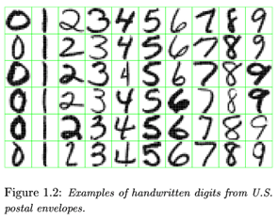
vertical lines

Slide 42
Horizontal lines
63

Slide 43
Small circles
63

Slide 44
Small circles
1
But what about position invariance ???
our example unit detectors were tied to
specific parts of the image
63

Slide 45
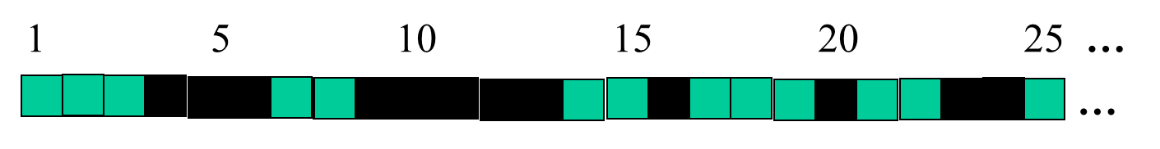
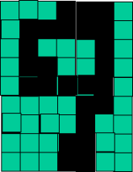
successive layers can learn higher-level features …
detect lines in
Specific positions
etc …
Higher level detetors
( horizontal line,
“RHS vertical lune”
“upper loop”, etc…
etc …
v

Slide 46
So: multiple layers make sense

Slide 47
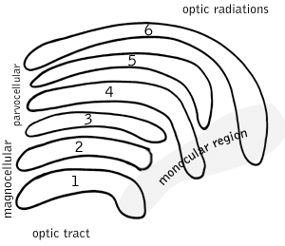
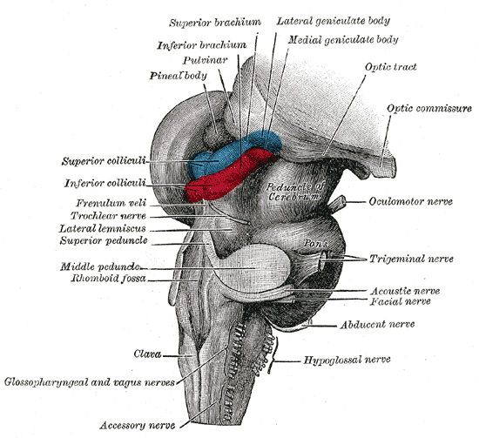
So: multiple layers make sense
Our brain works that way

Slide 48
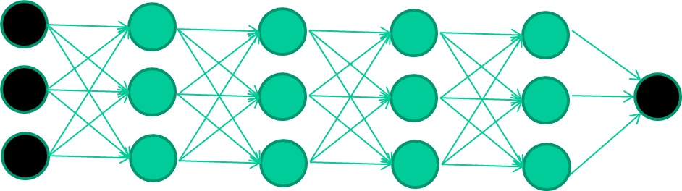
So: multiple layers make sense
Many-layer neural network architectures should be capable of learning the true underlying features and ‘feature logic’, and therefore generalise very well …

Slide 49


But, until very recently, our weight-learning algorithms simply did not work on multi-layer architectures
Along Came Deep Learning…….

Slide 50
The new way to train multi-layer NNs…

Slide 51
The new way to train multi-layer NNs…
Train this layer first

Slide 52
The new way to train multi-layer NNs…
Train this layer first
then this layer

Slide 53
The new way to train multi-layer NNs…
Train this layer first
then this layer
then this layer

Slide 54
The new way to train multi-layer NNs…
Train this layer first
then this layer
then this layer
then this layer

Slide 55
The new way to train multi-layer NNs…
Train this layer first
then this layer
then this layer
then this layer
finally this layer

Slide 56
The new way to train multi-layer NNs…
EACH of the (non-output) layers is trained to be an auto-encoder
Basically, it is forced to learn good features that describe what comes from the previous layer

Slide 57
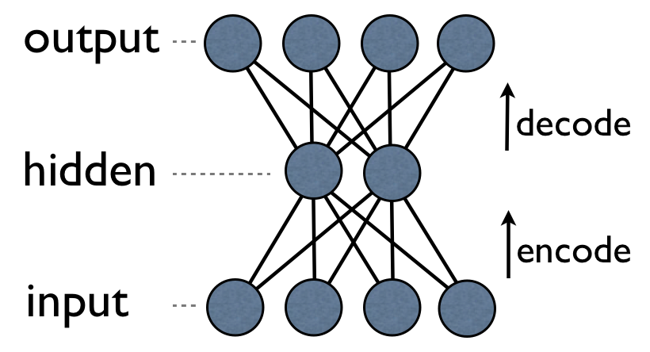
an auto-encoder is trained, with an absolutely standard weight-adjustment algorithm to reproduce the input

Slide 58
an auto-encoder is trained, with an absolutely standard weight-adjustment algorithm to reproduce the input
By making this happen with (many) fewer units than the inputs, this forces the ‘hidden layer’ units to become good feature detectors

Slide 59
intermediate layers are each trained to be auto encoders (or similar)

Slide 60
Final layer trained to predict class based on outputs from previous layers

Slide 61
And That’s the basic idea behind deep learning
There are many types of deep learning
Different kinds of autoencoder, variations on architectures and training algorithms etc…
It’s a fast growing area …

Slide 62
Common DNNs
Deep Convolutional Neural Network (DCNN)
To extract representation from images
Recurrent Neural Network (RNN)
To extract representation from sequential data
Deep Belief Neural Network (DBN)
To extract hierarchical representation from a dataset
Deep Reinforcement Learning (DQN)
To prescribe how agents should act in an environment in order to maximize future cumulative reward (e.g., a game score)
We cover DCNN & RNN today

Slide 63
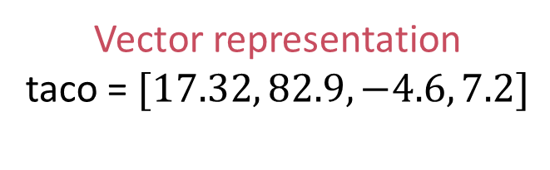
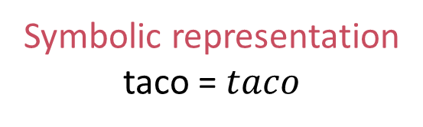
Comparing Representations
Vector representation
taco = $[17.32, 82.9, −4.6, 7.2]$
Symbolic representation taco = $taco$
Vectors have a similarity score.
A taco is not a burrito but similar.
Symbols can be the same or not.
A taco is just as different from a burrito as a Toyota.
Vectors have internal structure [Mikolov et al., 2013].
Italy – Rome = France – Paris
King – Queen = Man – Woman
Symbols have no structure.
Vectors are grounded in experience.
Meaning relative to predictions.
Symbols are arbitrarily assigned.
Meaning relative to other symbols.

Slide 64
Common Open-Source DL Frameworks
Non-symbolic
Symbolic
Torch, Caffe
Manual optimization
Memory intensive
CNTK, MXNET, Theano, TensorFlow
Automatic optimization
Memory reuse
Notes:
In a non-symbolic or imperative framework, a program is executed in a given order
A symbolic framework is a tensor graph of vector operations, such as matrix add/multiply or convolution
It allows users to invent new complex layer types without implementing them in a low-level language

Slide 65
Deep learning and computer vision

Slide 66
Vision is hard
Vision is hard because images are big matrices of numbers.
How a computer sees an image [22, 81, 44, 88, 17, 0, ..., 45]
Even harder for 3D objects.
You move a bit, and everything changes.
Example from MNIST handwritten digit dataset [LeCun and Cortes, 1998].

Slide 67
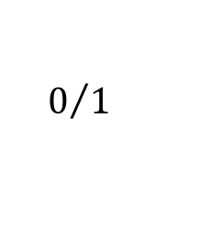
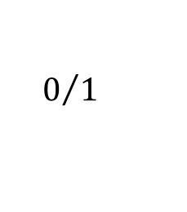
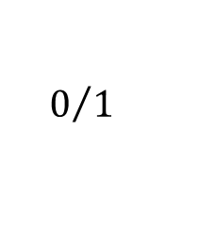
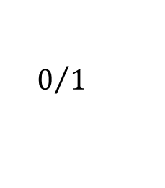
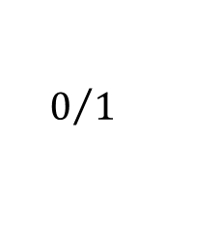
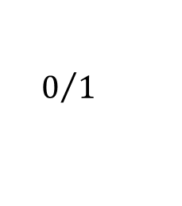
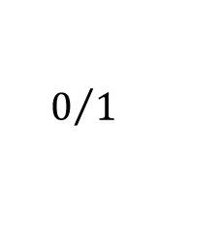
RBM: Unsupervised Model
Stochastic binary neuron
Probabilistically outputs 0 (turns off) or 1 (turns on) based on the weight of the inputs from on units.
$$0/1$$
Limit connections to be from one layer to the next.
Fast because decisions are made locally.
Trained in an unsupervised way to reproduce the data.
$$0/1$$
$$0/1$$
$$0/1$$
$$0/1$$
$$0/1$$
$$0/1$$
Notes:
Big breakthrough in 2006 by Hinton et al.
Use a network with symmetric weights called a restricted Boltzmann machine.

Slide 68
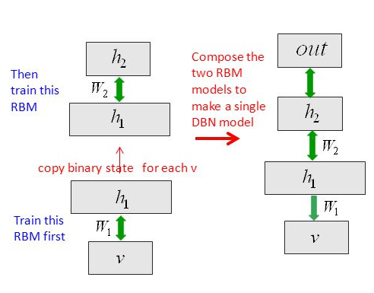
Stack up the layers to make a DBN
*Huang et al., Communications ACM 01/2014
Notes:
DBN:
A model by Hinton et al.
RBMs can be stacked and trained in a greedy manner to form so-called Deep Belief Networks
DBNs can extract a deep hierarchical representation of the training data e.g music autofill

Slide 69
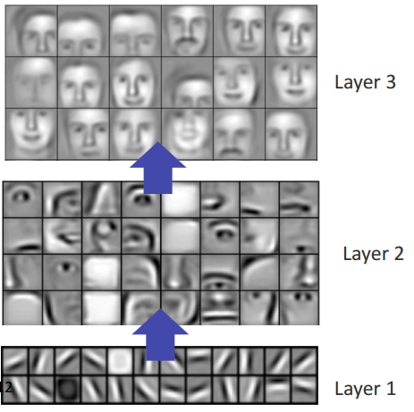
Computer vision, scaling up
Unsupervised learning was scaled up by Honglak Lee et al. [2009] to learn high-level visual features.
Further scaled up by Quoc Le et al. [2012].
Used 1,000 machines (16,000 cores) running for 3 days to train 1 billion weights by watching YouTube videos.
The network learned to identify cats.
The network wasn’t told to look for cats, it naturally learned that cats were integral to online viewing.
[Lee et al., 2009]

Slide 70
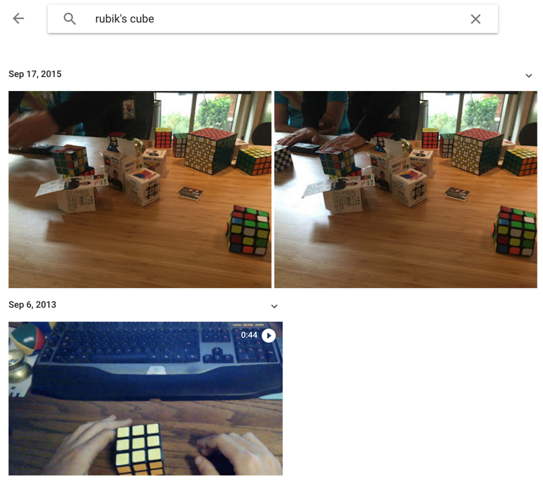
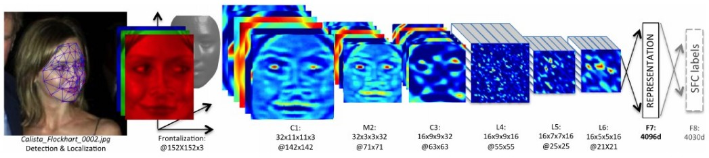
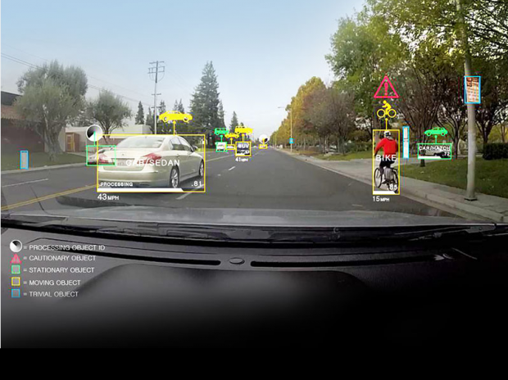
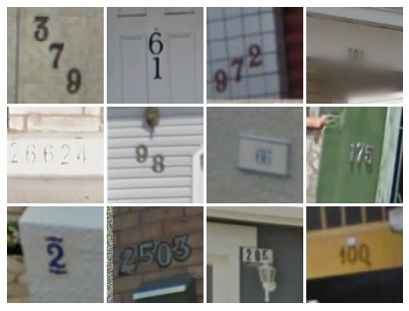
Supervised: ConvNets are everywhere
Face Verification, Taigman et al. 2014 (FAIR)
e.g. Google Photos search
[Goodfellow et al. 2014]
Self-driving cars
*Andrej Karpathy’s recent presentation

Slide 71
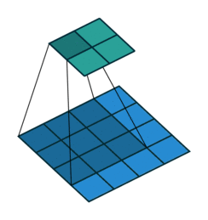
Convolution Layer
Filters always extend the full depth of the input volume
32x32x3 image
5x5x3 filter
32
Convolve the filter with the image
i.e. “slide over the image spatially, computing dot products”
Convolving a 3 X 3 kernel over a 4 X 4 input
32
3
*Andrej Karpathy’s recent presentation
*http://iamaaditya.github.io/2016/03/one-by-one-convolution/

Slide 72

Pooling layer
makes the representations smaller and more manageable
operates over each activation map independently
*Andrej Karpathy’s recent presentation
Notes:
It is also referred to as a down sampling layer. In this category, there are also several layer options, with max pooling being the most popular. This basically takes a filter (normally of size 2x2) and a stride of the same length. It then applies it to the input volume and outputs the maximum number in every subregion that the filter convolves around.
As you can imagine, this layer drastically reduces the spatial dimension of the input volume. This serves two main purposes. The first is that the amount of parameters or weights is reduced by 75%, thus lessening the computation cost. The second is that it will control overfitting

Slide 73
Max Pooling
Single depth slice
1 | 1 | 2 | 4
5 | 6 | 7 | 8
3 | 2 | 1 | 0
1 | 2 | 3 | 4
x
max pool with 2x2 filters and stride 2
6 | 8
3 | 4
y
*Andrej Karpathy’s recent presentation

Slide 74

Fully Connected Layer (FC layer)
*Andrej Karpathy’s recent presentation
Notes:
Contains neurons that connect to the entire input volume, as in ordinary Neural Networks

Slide 75
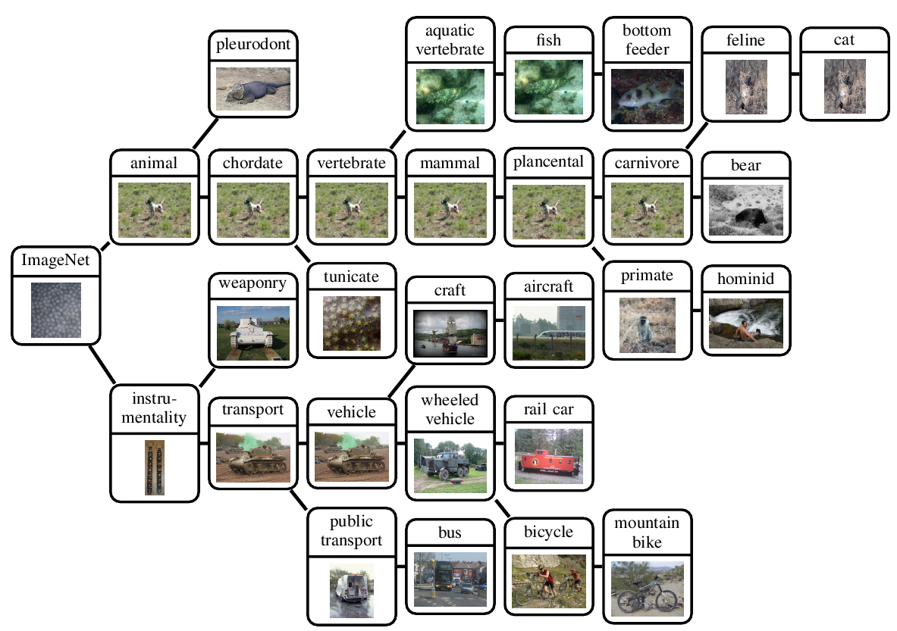
IMAGENET
*http://groups.inf.ed.ac.uk/calvin/imagenet/prototypes.html
Notes:
An image database of 1 million natural images
It has 1000 labels
It has been used in multiple image competitions and is used as standard
Berkley Vision and Learning center (BLVC) have trained DNN models on ImageNet, and made the pre-trained weights publicly available.

Slide 76
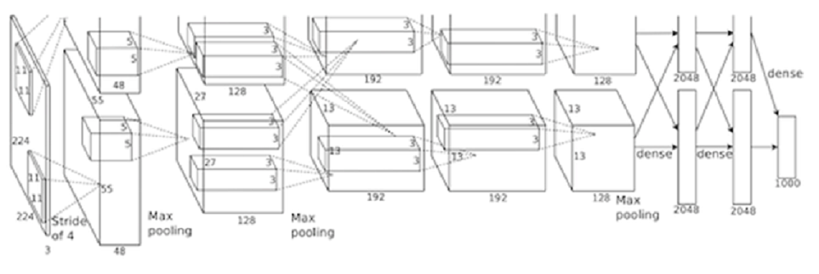
AlexNet
*https://papers.nips.cc/paper/4824-imagenet-classification-with-deep-convolutional-neural-networks.pdf
Notes:
Developed by Krizhevsky, Sutskever, and Hinton in 2012
Record breaking performance on ImageNet dataset
Utilizes data augmentation and dropout

Slide 77
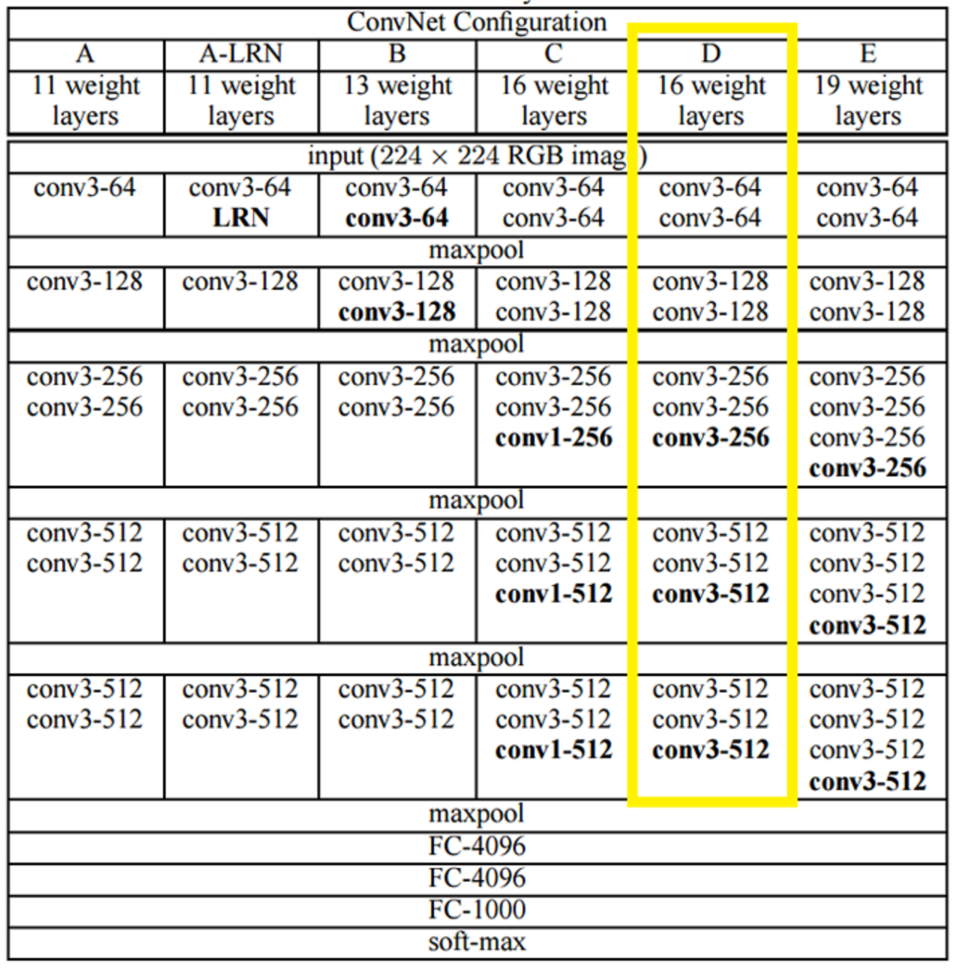
VGGNet
*http://arxiv.org/pdf/1409.1556v6.pdf
Notes:
Karen Simonyan and Andrew Zisserman of the University of Oxford created a 19 layer CNN
It used 3x3 filters with stride and pad of 1, along with 2x2 maxpooling layers with stride 2
It reinforced the notion that convolutional neural networks have to have a deep network of layers in order for the hierarchical representation of visual data to work

Slide 78
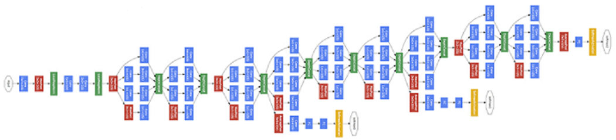
GoogLeNet
*http://www.csc.kth.se/~roelof/deepdream/bvlc_gnet.html
Notes:
GoogLeNet is a 22 layer CNN and was the winner of ILSVRC 2014 with a top 5 error rate of 6.7%.
GoogLeNet was one of the first models that introduced the idea that CNN layers didn’t always have to be stacked up sequentially.
This model places notable consideration on memory and power usage.
However, stacking all of these layers and adding huge numbers of filters has a computational and memory cost, as well as an increased chance of overfitting.
I often use a L2 regularizer to avoid overfitting.

Slide 79
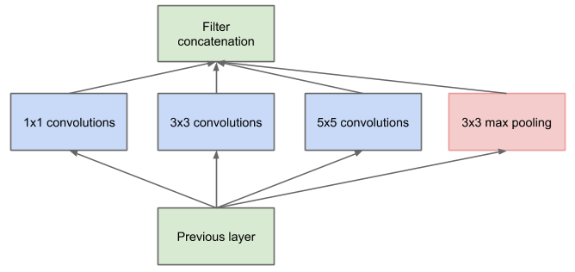
GoogLeNet uses Inception
Inception Module
*https://arxiv.org/pdf/1409.4842v1.pdf
Notes:
In GoogLeNet not everything is happening sequentially. Pieces of this network are happening in parallel.
The bottom green box is our input and the top one is the output of the model. Inception module allows us to perform convolution and pooling operations in parallel.
Inception module creates a network in network convolution, which extracts information about the very fine grain details in the volume.
Inception module also have a pooling operation that helps to reduce spatial sizes and combat overfitting.
Inception modules have ReLUs after each conv layer, which helps improve the nonlinearity of the network.
Thus, the network is able to perform the functions of these different operations while still remaining computationally considerate.

Slide 80
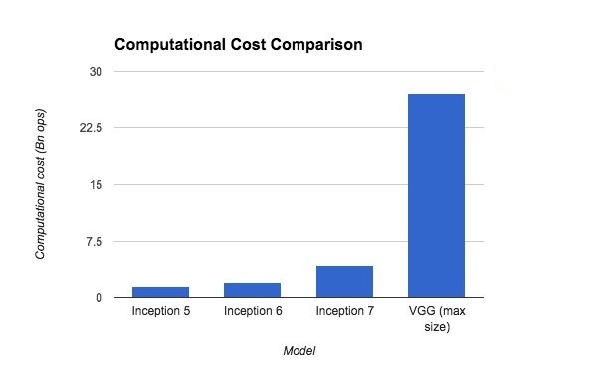
Inception Performance comparison
*http://lsun.cs.princeton.edu/slides/Christian.pdf

Slide 81
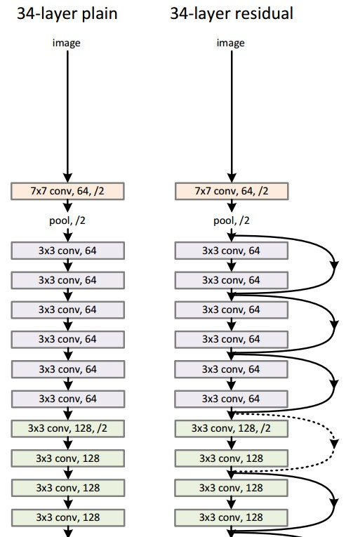
Microsoft ResNet
*https://arxiv.org/pdf/1512.03385v1.pdf
Notes:
ResNet is a model by MSR
It is a very deep network architecture with 152 layers
ResNet won ILSVRC 2015 with an incredible low error rate of 3.6%
It sets new records in classification, detection, and localization

Slide 82
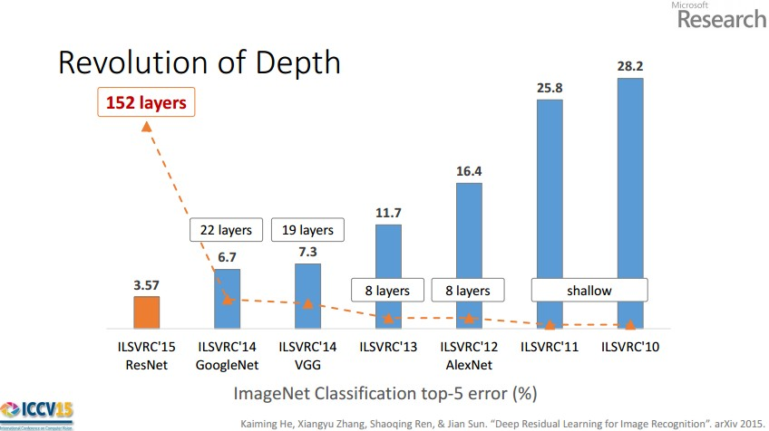
*Andrej Karpathy’s recent presentation

Slide 83
Deep learning and natural language processing

Slide 84
Deep learning enables sub-symbolic processing
I
bought
a
car
.
<i>
<bought>
<a>
<car>
<.>
You have to remember to represent “purchased” and “automobile.”
What about “truck”?
How do you encode the meaning of the entire sentence?

Slide 85
But what about a sentence?
Algorithm for generating vectors for sentences
Make the sentence vector be the vector for the first word.
For each subsequent word, combine its vector with the sentence vector.
The resulting vector after the last word is the sentence vector.
Can be implemented using a recurrent neural network (RNN)

Slide 86
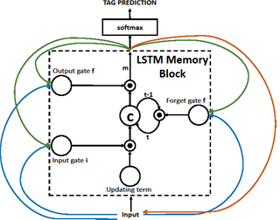
LSTM RNN
*Huang et al., Communications ACM 01/2014
Notes:
RNN:
Recurrent neural networks (RNN) are networks with loops in them, allowing information to persist.
Long Short Term Memory (LSTM) networks are a special kind of RNN, capable of learning long-term dependencies.
Good for state-wise (step-by-step) caption generation task.

Slide 87
What can you do with a Sentence Vector?
You can feed it to a classifier.
You can unwind in the other direction to do machine translation.
Called a seq2seq model, or Neural Machine Translation, or encoder-decoder model.

Slide 88
Deep learning and question answering
Bob went home.
Tim went to the junkyard.
Bob picked up the jar.
Bob went to town.
Where is the jar? A: town
Memory Networks [Weston et al., 2014]: Updates memory vectors based on a question and finds the best one to give the output.
The office is north of the yard.
The bath is north of the office.
The yard is west of the kitchen.
How do you go from the office to the kitchen? A: south, east
Neural Reasoner [Peng et al., 2015]: Encodes the question and facts in many layers, and the final layer is put through a function that gives the answer.

Slide 89
Other commonly used DNNs

Slide 90
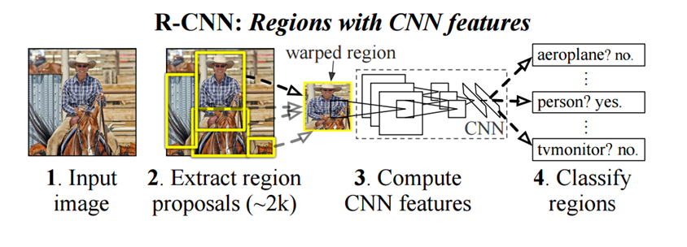
Region Based CNN (RCNN)
*https://arxiv.org/pdf/1311.2524v5.pdf
Notes:
Ross Girshick and his group at UC Berkeley created this model
Determines a specific object’s exact location
RCNNs has become a standard for object detection.
Faster-RCNNS are an improved version of this model with utilizes ResNet

Slide 91
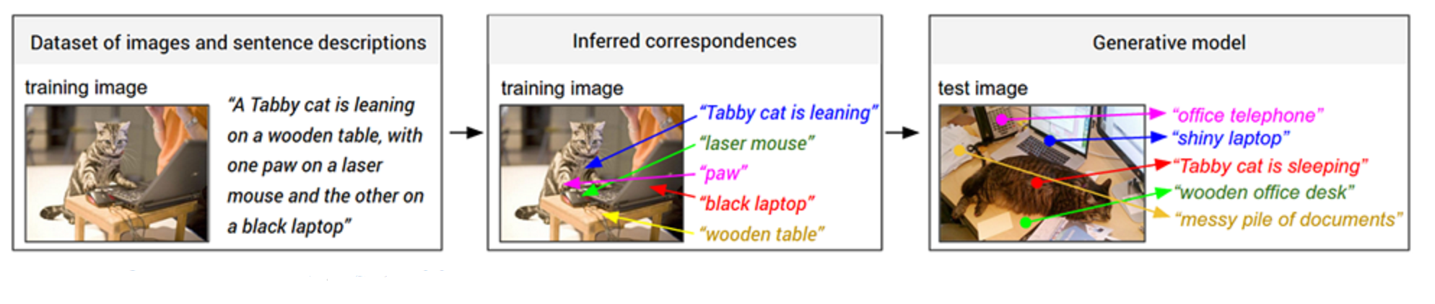
Generating Image Descriptions (CNN-RNN)
*https://arxiv.org/pdf/1412.2306v2.pdf
Notes:
Andrej Karpathy and Fei-Fei Li created this model
It combines the fields of Computer Vision and Natural Language Processing
It uses CNNs and bidirectional RNNs to generate natural language descriptions of different image regions

Slide 92
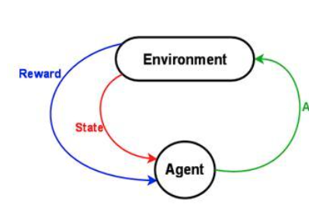
Deep Reinforcement Learning

Slide 93
Deep Learning – Some use-cases in next 5 years?

Slide 94
Advanced Melanoma Screening and Detection
Researchers at the University of Michigan are putting advanced image recognition to work, detecting one of the most aggressive, but treatable in early stages, types of cancer.
The team trained a neural network to isolate features (texture and structure) of moles and suspicious lesions for better recognition and detecting melanoma known to date.

Slide 95
Neural Networks for Brain Cancer Detection
A team of French researchers is working on spotting invasive brain cancer cells during surgery.
They found that using neural networks in conjunction with Raman spectroscopy during operations allows them to detect the cancerous cells easier and reduce residual cancer post-operation.

Slide 96
Neural Networks in Weather Forecasting and Event Detection
This traditional area for large-scale supercomputers is now becoming a hotbed for neural network development, particularly when it comes to weather event (pattern) detection.
In one such use case, computational fluid dynamics codes are matched with neural networks and other genetic algorithm approaches to detect cyclone activity.

Slide 97
Neural Networks in Finance
Trading and risk management are two areas where we would expect to see developments for neural networks
Popular technical indicators along with neural networks and genetic algorithms are used to generate buy and sell signals for each stock and for portfolios of stocks

Slide 98
What deep learning still can’t do?

Slide 99
What deep learning still can’t do
System 1: Fast and Parallel
With computer vision, we seem to be on the right track
Reinforcement learning is useful in increasingly large worlds
System 2: Slow and Serial
Still lacking in common sense
Language processing needs a grounded understanding

Slide 100
Limitations of deep learning
The encoded meaning is grounded with respect to other words.
There is no linkage to the physical world.
Bob went home.
Tim went to the junkyard.
Bob picked up the jar.
Bob went to town.
Where is the jar? A: town
Deep learning has no understanding of what it means for the jar to be in town.
For example that it can’t also be at the junkyard. Or that it may be in Bob’s car, or still in his hands.

Slide 101
Increasing Re-usability of Deep Learning models

Slide 102
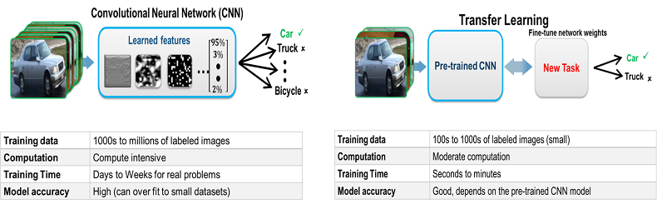
Transfer Learning & Fine-tuning
*http://www.mathworks.com/discovery/deep-learning.html?requestedDomain=uk.mathworks.com
Notes:
Transfer Learning is the process of taking a pre-trained model and “fine-tuning” the model with our own dataset

Slide 103
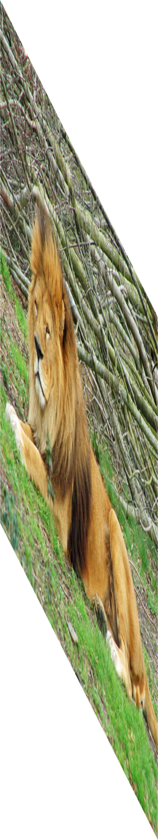
Convolutional Neural Networks: AlexNet
Lion
Image
labels
Krizhevsky, Sutskever, Hinton — NIPS 2012
Notes:
Successful training of a very large CNN on imagenet data to predict one of the thousand classes.
We know these models are working

Slide 104



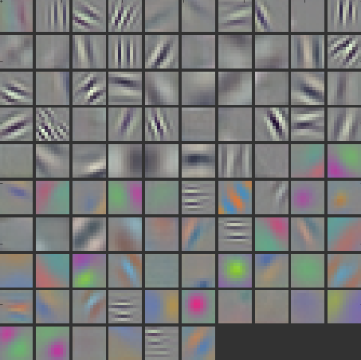
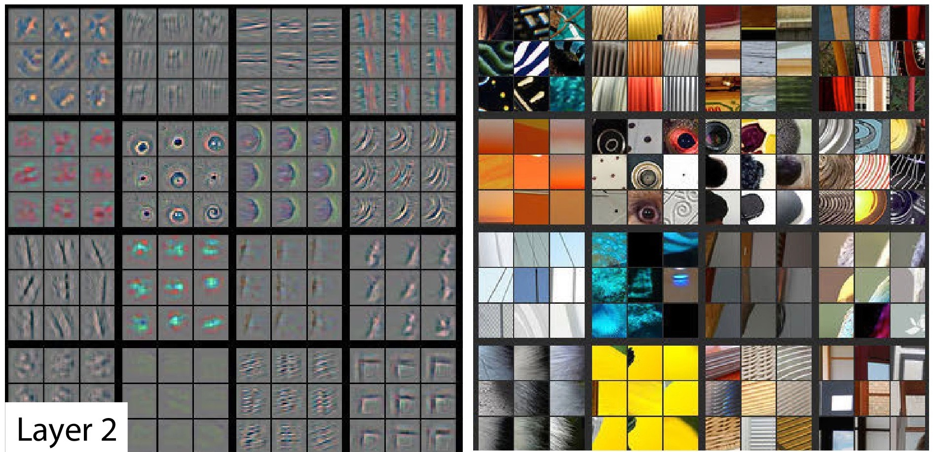
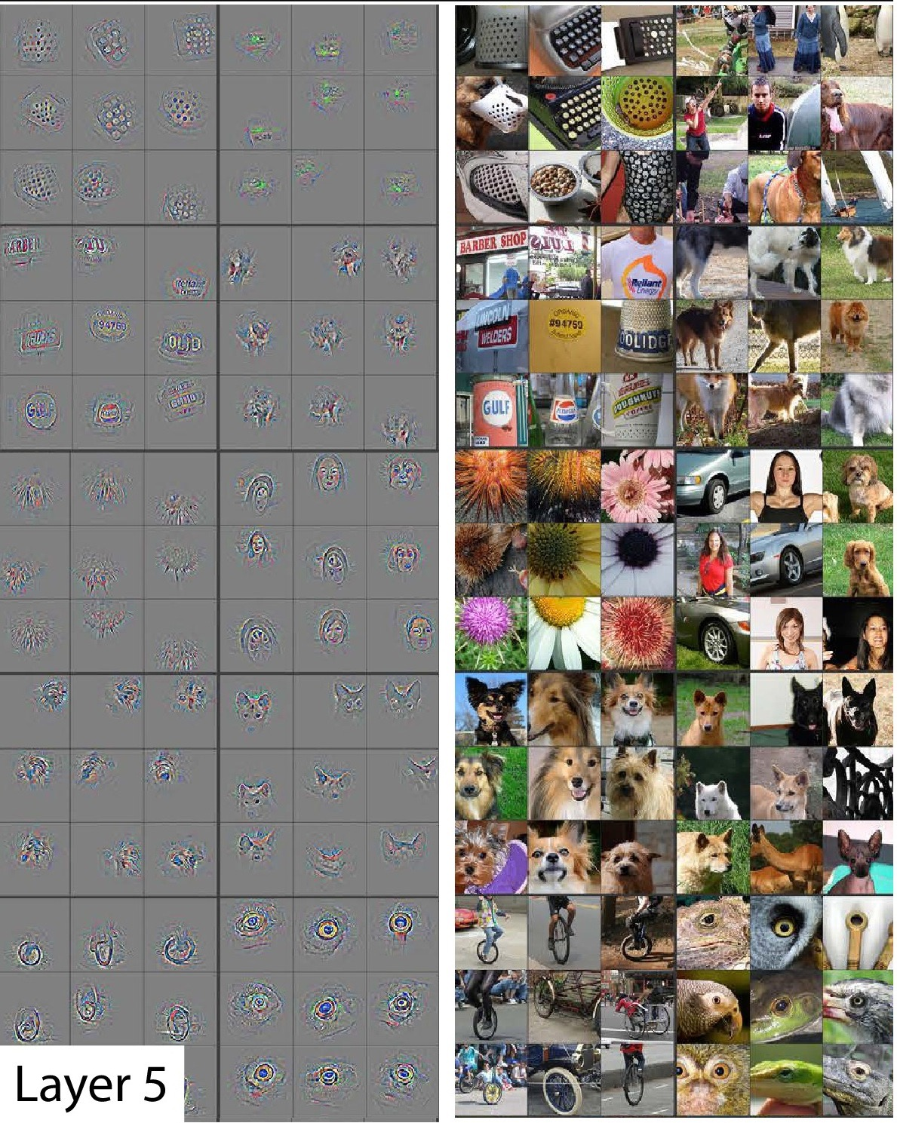
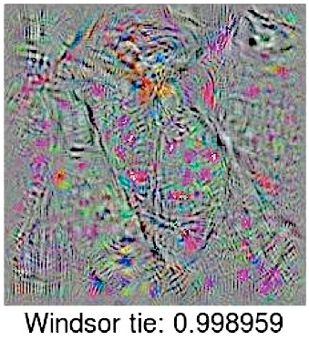
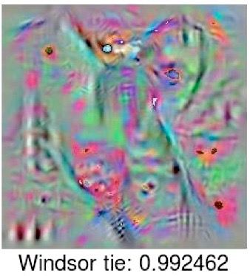
Layer 1
Filter (Gabor and color blobs)
Layer 2
Layer 5
Last
Layer
Zeiler et al.
arXiv 2013, ECCV 2014
Nguyen et al.
arXiv 2014
Gabor filter: linear filters used for edge detection with similar orientation representations to the human visual system
Notes:
It is clear THAT they work, but not as clear WHY or HOW.
WHAT’s going on in the middle?
LET’S think about what we DO KNOW.
It does not matter what dataset you use or what task you are training on, the first layer is always a gabor filter.

Slide 105
general
??
??
??
Lion
specific
Layer number
Notes:
At the beginning layers we learn features that are general. At the last layers, we learn features that are specific to the target task. The question is how this transition occurs. We quantify the transition using transfer learning.

Slide 106
Transfer Learning Overview
Defining transfer learning
How it works
Frozen weights
Fine tuning
Selffer
Fine tuner
Transfer
Figure for demonstrating how backprop woks
Input A
Task A
Layer n
Transfer
AnB: Frozen Weights
Forward Propagation
Task B
Input B
Task B
Back-propagation
AnB⁺: Fine-tuning

Slide 107















ImageNet
dataset
A
500 Classes
dataset
B
1000 Classes
500 Classes
Notes:
okapi

Slide 108
baseA
A Images
baseB
B Images

Slide 109
A Images
A Labels

Slide 110
B Images
B Labels
Hypothesis: if transferred features are specific to task A, performance drops. Otherwise the performance should be the same.

Slide 111

transfer
AnB
Compare to
B Images
B Labels
baseB

Slide 112

Can the features be exploited for any vision tasks?
CNN representation replaces pipelines of service-oriented architecture (s.o.a) methods and achieve better results.

Slide 113

4 types of Transfer Learning
1. Train on
Imagenet
2. Small dataset:
feature extractor
3. Medium dataset:
finetuning
more data = retrain more of the network (or all of it)
Freeze these
Freeze these
Train this
Train this
*Andrej Karpathy’s recent presentation

Slide 114

Transfer Learning

Slide 115
Data Augmentation:
Given pre-trained ConvNet, augmentation applied at test time

Slide 116
Data Augmentation:

Slide 117
Use Cases

Slide 118

GPUs in Azure
Notes:
Azure introduced GPUs with its N-Series preview availability
There are 3 types on configurations available for deep learning tasks
NC6 with 1 X NVIDIA Tesla K80 GPU
NC12 with 2 X NVIDIA Tesla K80 GPUs
NC24 with 4 X NVIDIA Tesla K80 GPUs

Slide 119

Azure GPU VM
Used Ubuntu 16.04 N-Series VM
NC24 VM with 4 NVIDIA Tesla K80

Slide 120
DL Framework: MXNET
DL toolkit by DMLC (2015)
Supports almost all common DL models
Supports multi-GPU training
Supports distributed training
Python/R support

Slide 121

Case Study I: ResNet on CIFAR 10
Based on Microsoft Blog on how to use MXNET with MRO/MRS
Used MXNET with MRO and 1 GPU
*Tao Wu and Team, Microsoft
Notes:
This case study is based on a Microsoft Blog by Tao wu and Team
They explain step by step how to setup MXNET with Microsoft R Server (MRS)
Then they run an R script to train Resnet on CIFAR 10 dataset (as we can see from the image)

Slide 122
Case Study II: Finetuning pre-trained Inception BN Network
Used an ImageNet pretrained Inception BN Network
Used MXNET with anaconda python and 4 GPUs
Try to predict contents of a new unseen image

Slide 123


Using trained Inception BN Model

Slide 124
DL Framework : Theano (Lasagne/Keras)
Developed by a group at Université de Montréal (2007)
Easy to customize with domain-specific data
Experimental multi-GPU support (through Platoon)
Experimental distributed (only through Keras)
Great Python support

Slide 125
Case Study III: Diabetic Retinopathy Prediction
Used labeled fluorescein angiography images of eyes to improve Diabetic Retinopathy (DR) prediction (Kaggle)
Used a DCNN to improve DR prediction
Used Theano+Lasagne+Keras with anaconda python and 1 GPU

Slide 126


Diabetic Retinopathy

Slide 127
Fine-tuning DCNN model
ImageNet pre-trained GoogleNet
Trained ImageNet features transferred as initial weights for DR prediction.
Lower layers (first 2 layers) of the pre-trained DCNN contain generic features/weights that can be used for the DR prediction task.

Slide 128

Reduce Overfitting: Augmentation

Slide 129


Transfer Learning DCNN
*http://benanne.github.io/2015/03/17/plankton.html

Slide 130


Fine-tuning GoogleNet

Slide 131

Training Fine-tuned DCNN model

Slide 132

Diabetic Retinopathy Prediction
Epoch 449: Train cost 8.994, Train acc 0.607, val acc 0.798, val AUC 0.849

Slide 133

Using GPU-Trained model in AML

Slide 134

AML Web Service Batch-Test

Slide 135




Other Uses of this DCNN Model

Slide 136
Case Study IV: Image Caption Generation
Used the ImageNet-trained DCNN and learn MS COCO image features through transfer learning and fine-tuning
Used a Long short-term memory (LSTM) Recurrent Neural Network (RNN) on these learned image features for the image caption generation

Slide 137

Deep CNN-RNN Model

Slide 138


Caption generation using fine-tuned CNN-RNN model

Slide 139
Re-usability of this CNN-RNN Model
Used CNN-RNN model for natural image caption generation
Can use the same CNN-RNN model in a completely different domain

Slide 140
Case Study V: Fashion Image Tag Prediction
We use the ImageNet-trained DCNN and learn Apparel Classification with Style (ACS) image features through transfer learning and fine-tuning
Then we use a Long short-term memory (LSTM) Recurrent Neural Network (RNN) on the learned image features for the image caption generation

Slide 141

Augmentation + Transfer Learning

Slide 142
Using the same CNN-RNN Model

Slide 143

ACS Images Tag Prediction

Slide 144


Using fine-tuned CNN-RNN model

Slide 145
DL Framework: TensorFlow
DL toolkit by Google (2016)
Supports all common DL models
Supports multi-GPU training
Supports native distributed training
Great Python Support

Slide 146

Case Study VI: Transfer Learning on pre-trained AlexNet

Slide 147

Training on Cats & Dogs Images

Slide 148

Validating on Cats & Dogs Images

Slide 149

Classifying Cats & Dogs

Slide 150


Case Study VII: Similar Image Retrieval

Slide 151

Case Study VIII: Similar Image Retrieval

Slide 152
Computational Network Toolkit (CNTK)
DL toolkit by Microsoft Research (2016)
Supports almost all common DL models
Supports multi-GPU training
Supports native distributed training
C++/Python Support
Example: https://github.com/Microsoft/CNTK/wiki/Object-Detection-using-Fast-R-CNN

Slide 153
Demos/Hands-on

